Slide 1
Study on Machine Learning approach using Fingerprint Recognition System Paper Presentation
Group No. 15 1. Name: Iffat Ara Jui. Id: 23166010 2. Name: Md. Shajeebul Islam Sk. Id: 22366027 3. Name: Fatema Tuz Zohora. Id: 22366015 4. Name: Jubayer Ishfaq Rafid. Id: 21101149
ST: Ehsanur Rahman Rhythm RA: Md. Sabbir Hossain Course Teacher: Annajiat Alim Rasel

Slide 2
Abstract
-The pattern of fingerprints are permanent and unchangeable. on each finger during all the life. In situations where algorithmic methods are either unavailable or too computationally intensive, neural networks allow for the solution of issues.
-An application for neural networks that seems appropriate is the issue of feature extraction and classification. When compared to traditional technique, they give a substantial speed advantage.
-Fingerprints are distinctive and remain enduring throughout a person’s life. The automatic fingerprint recognition system based on ridges and it’s characteristics known as minutiae. It is extremely important to mark these minutiae accurately.

Slide 3
Abstract
-In this paper, we have used ridge termination and ridge bifurcation as minutiae for fingerprint recognition system. At the time of analysis, the approaches of attributes impart better result. -With this technique recognition rate of this intended method of fingerprint recognition system using neural network is quite impressive. -From the extraction outcome we may infer about a very affirmative impact of neural network on recognition rate.

Slide 4
Introduction
-Fingerprint recognition refers to the automated method of identifying or confirming the identity of an individual based on the comparison of two fingerprints. -Fingerprint recognition is one of the most well known biometrics, and it is by far the most used biometric solution for authentication on computerized systems. -The reasons for fingerprint recognition being so popular are the ease of acquisition, established use and acceptance when compared to other biometrics, and the fact that there are numerous (ten) sources of this biometric on each individual.

Slide 5
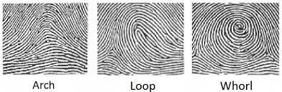
Introduction
-A fingerprint is one of the more popularly used biometrics used in-person identification. This is because fingerprints are easy to collect, examine and classify. No two persons have been found with the same fingerprints and are found to be unique. -There are three basic fingerprint patterns: the arch, the loop And the whorl. -These patterns are defined by structures known Identify applicable funding agency here. The core of the print is the central area. A delta is a triangle-shaped area of a fingerprint where the ridge formation changes direction.

Slide 6
Introduction
-The overall fingerprint structure in different layers to identify it and learn the basic structure of it: it is generally trained using A basic structural division of a fingerprint are: (1) Global structure (2) Low level structure and (3) Low level structure. -The first one represents the overall shape of the finger. Thus, the second one represents the valleys and ridges format at local intersecting region, and the later. i.e the low level structure represents the sweat pores on the fingerprint skin. -Manual observations of a fingerprint are prone to inconsistency and can lead to errors. manual fingerprint matching is time-consuming and may lead to errors.

Slide 7
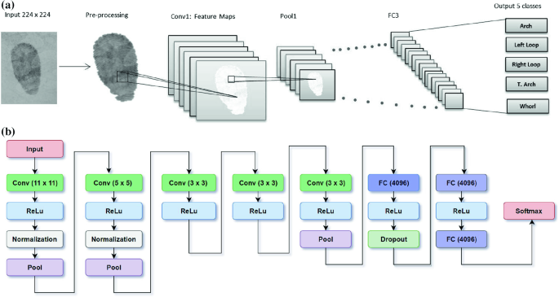
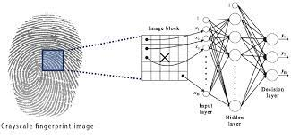
Introduction
-The most widely used system is automatic fingerprint identification system (AFIS) which has replaced human experts in fingerprint recognition as well as classification. -it begins with the (I) enrollment phase, which basically involves the registration phase where the individual identity( the fingerprint structure) is fed to the machine for it to learn and later identify, the second phase is called the identification phase.

Slide 8
Literature Review
-All the fingerprint identification different types of work have been done so far. -We have gone through various research papers, till today the methods used different algorithms. These algorithms intend to profit from on this uniqueness to develop the efficiency and provision for matching accuracy the fingerprint the fingerprint recognition and confirmation. -In this paper neural network back propagation for trained the fingerprint classifier to identify the fingerprints with time efficient preprocessing. -Biometric measures the uniqueness of an individual based on the physiological, biological and behavioral properties of their body.

Slide 9
Literature Review
-This tool presents itself as a reliable scientific method to identify and authenticate an individual which are fundamental security principles. -The present work makes a contribution on fingerprint recognition which is robust method and has the advantage of security, many attacks are emerging. -In field of fingerprint there are fake fingerprints are made by using printed fingerprints, silicone, wood glue or other products. An alternative to classical fingerprint biometrics research is being done on finger veins. -This technology uses infrared to observe vein features. The use of infrared has the advantage of extracting characteristics from the skin of finger and from the veins of the fingers to avoid forgery, because veins cannot be forged.

Slide 10
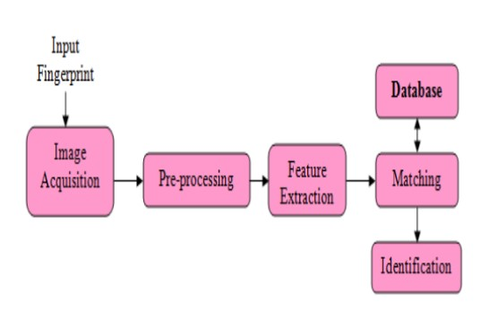
Literature Review
-More and more studies are made on multimodal biometrics. In this studies, at least two modalities are used. Faced with the complexity and precision of the textures of the sweat bread and fingerprints several studies are interested in the dual of iris paints. -Recent research focuses on deep learning, which is widely used in computer vision and mainly in biometrics. It’s success is due to its robustness with better recognition scores. The study done in this work shows the performance of convolutional neural networks in fingerprint recognition CNN algorithm were applied to the fingerprint database.

